Slide 1

43rd HUST Annual Student Research Conference
A Collaborative Multi-agent Reinforcement Learning-Based Framework for Automated Related Work Summarization
ID: S.1.17
Students: Dang Hai Dang, Pham Bao Yen, Nguyen Quang Huy, Do Truong Giang
Supervisor: Prof. Huynh Thi Thanh Binh, Dr. Nguyen Thi Huong
Hanoi University of Science and Technology
May 14, 2026

Slide 2
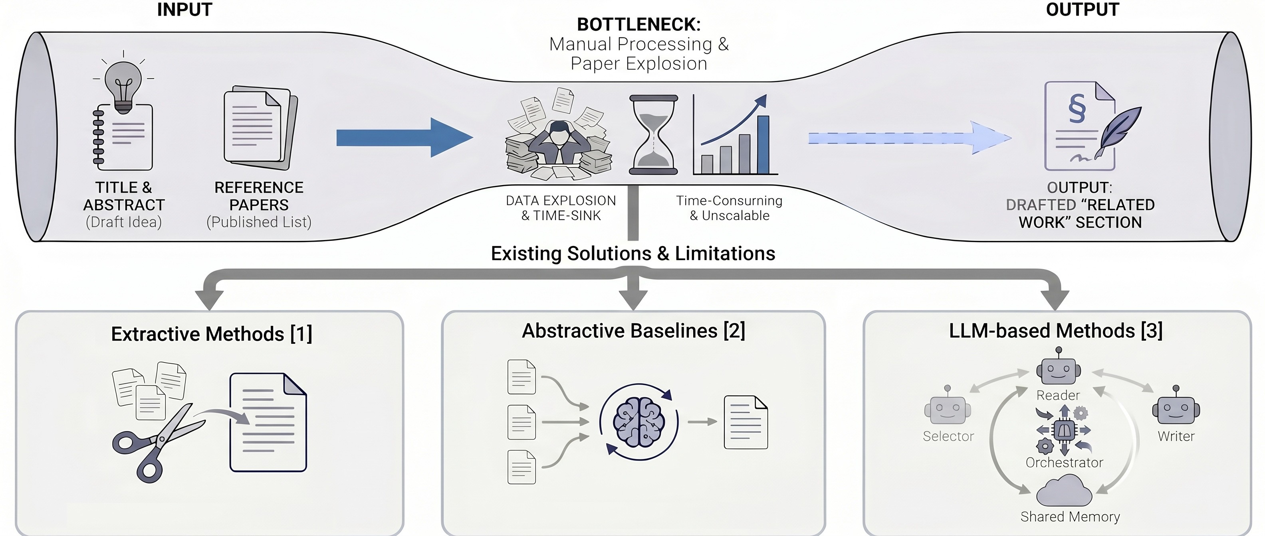
Problem Statement
Cong Duy Vu Hoang and Min-Yen Kan. “Towards automated related work summarization”. In: Coling 2010: Posters. 2010, pp. 427–435
Wen Xiao et al. “PRIMERA: Pyramid-based Masked Sentence Pre-training for Multi-document Summarization”. In: Proceedings of the 60th Annual Meeting of the Association for Computational Lin-guistics (Volume 1: Long Papers). 2022, pp. 5245–5263
Xiaochuan Liu et al. “Select, Read, and Write: A Multi-Agent Framework of Full-Text-based Related Work Generation”. In: Findings of the Association for Computational Linguistics (2025). Accepted for publication

Slide 3
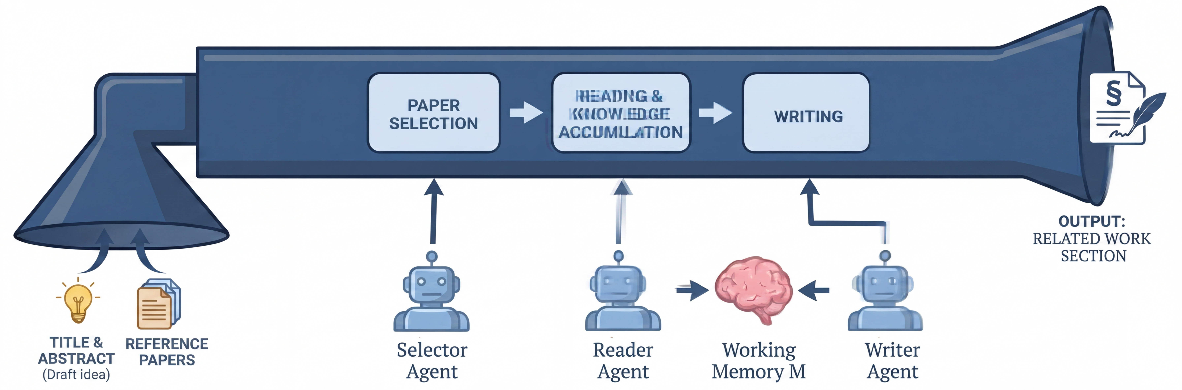
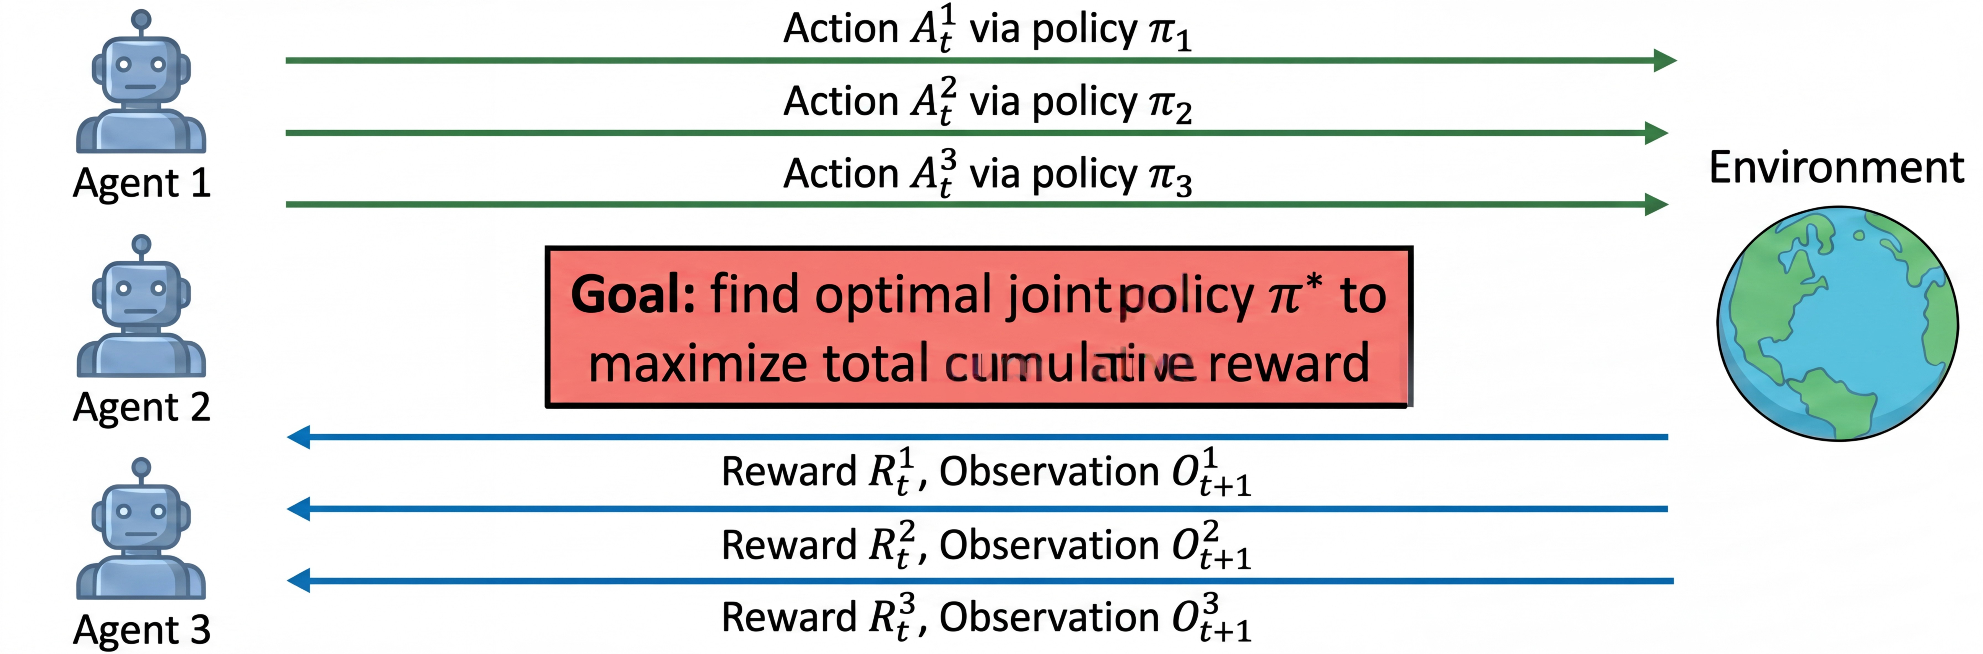
Proposed Framework
Figure 1: Prior work leveraging LLM-based method.
Figure 2: A Collaborative Multi-agent Reinforcement Learning-Based Framework (CREW).

Slide 4
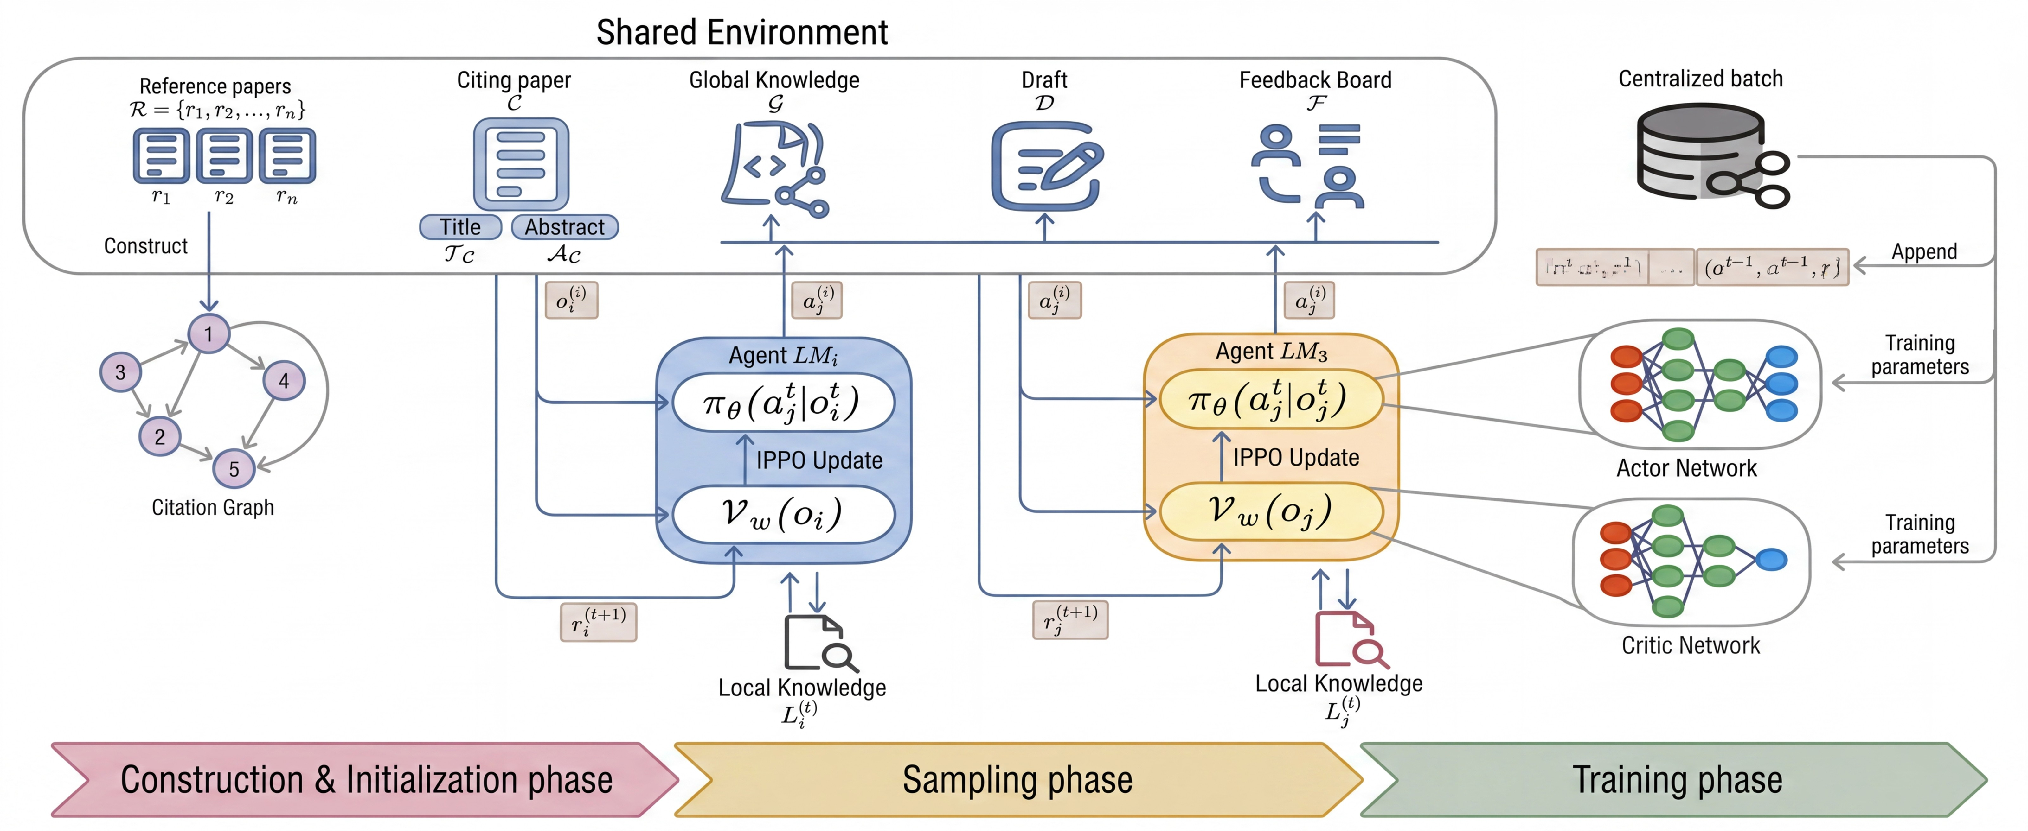
Architecture
Figure 3: Proposed system architecture overview.

Slide 5


Experimental Setup and Results
I Experimental Setup
Environment: Python 3.10, NVIDIA A100 GPU (Train & Infer: Qwen-32B-Instruct).
Dataset: OARelatedWork [4].
Metrics: LLM-as-a-Judge (inc. Coverage, Logic, Relevance) [3].
Baselines: PRIMERA [2], GPT-4o, Select-RW [3].
I Results
Table 1. Effectiveness
Cov. Log. Rel.
Table 2. Ablation Study
Log. Rel.
Model
Avg.
Tok.
Config
Cov.
Avg.
Tok.
PRIMERA GPT-4o
Select-RW
2.48 2.71 3.02 2.64 186K
3.18 4.08 3.96 3.36 2.1K
3.36 4.21 4.18 3.53 186K
w/o Draft w/o Crit. w/o BB.
3.41 (-.21)
3.35 (-.27)
3.29 (-.33)
4.02 (-.37)
4.08 (-.31)
3.95 (-.44)
4.10 (-.21)
4.02 (-.29)
3.98 (-.33)
3.50 (-.27)
3.42 (-.35)
3.35 (-.42)
150K
143K
160K
CREW 3.62 4.39 4.31 3.77 153K CREW 3.62 4.39 4.31 3.77 153K
[4] Martin Docekal, Martin Fajcik, and Pavel Smrz. “Oarelatedwork: A large-scale dataset of related work sections with full-texts from open access sources”. In: arXiv preprint arXiv:2405.01930 (2024)
[2] Wen Xiao et al. “PRIMERA: Pyramid-based Masked Sentence Pre-training for Multi-document Summarization”. In: Proceedings of the 60th Annual Meeting of the Association for Computational Lin-guistics (Volume 1: Long Papers). 2022, pp. 5245–5263
[3] Xiaochuan Liu et al. “Select, Read, and Write: A Multi-Agent Framework of Full-Text-based Related Work Generation”. In: Findings of the Association for Computational Linguistics (2025). Accepted for publication

Slide 6
Case Study
Target Paper: Robust Non-Rigid Registration of 2D and 3D Graphs
Abstract: We present a new approach to matching graphs in R² or R³ . Our method handles partial matches and non-linear deformations using Gaussian Processes, without requiring appearance features or initial alignment... [...]
Baseline: Select-RW [3] Ours: CREW
Advanced techniques have emerged to overcome these
limitations.
While [28637] and [27485] focus on geometric and
appearance priors,
One notable approach is the SoftPosit algorithm.
other methodologies such as spectral methods and deep learning have also
Despite its effectiveness, the SoftPosit algorithm
can still fail
in the
been explored.
Spectral methods, which leverage the eigenvalues and
presence of clutter or occlusions
[3755653]
.
eigenvectors of graph Laplacians, offer a powerful tool
for graph
To address these limitations, a recent paper
matching by capturing the intrinsic structure.
proposes an
These methods are particularly useful for regular
innovative solution
by integrating a GMM to refine pose priors
structures where dominant eigenvalues are present.
However, they
[3755653]
.
This method progressively refines
the pose estimates by
struggle with nonlinear deformations, which are
hypothesizing correspondences.
better handled by geometric approaches in [28637].
By reducing matches and exploring the pose space
more thoroughly,
this approach enhances the robustness and efficiency
[3755653]
.
[3] Xiaochuan Liu et al. “Select, Read, and Write: A Multi-Agent Framework of Full-Text-based Related Work Generation”. In: Findings of the Association for Computational Linguistics (2025). Accepted for publication

Slide 7
Conclusions and Future Work
I Conclusions
Collaborative Framework: Proposed CREW, a MARL-based system for automated related work summarization.
Empirical Success: Improved coverage, relevance, and logic through dynamic agent coordination.
I Future Work
System Expansion: Integrate external database crawling and dynamic online document graphs.
THANK YOU FOR LISTENING!

Slide 8

References I
Cong Duy Vu Hoang and Min-Yen Kan. “Towards automated related work summarization”. In: Coling 2010: Posters. 2010, pp. 427–435.
Wen Xiao et al. “PRIMERA: Pyramid-based Masked Sentence Pre-training for Multi-document Summarization”. In: Proceedings of the 60th Annual Meeting of the Association for Computational Linguistics (Volume 1: Long Papers). 2022,
pp. 5245–5263.
Xiaochuan Liu et al. “Select, Read, and Write: A Multi-Agent Framework of Full-Text-based Related Work Generation”. In: Findings of the Association for Computational Linguistics (2025). Accepted for publication.
Martin Docekal, Martin Fajcik, and Pavel Smrz. “Oarelatedwork: A large-scale dataset of related work sections with full-texts from open access sources”. In: arXiv preprint arXiv:2405.01930 (2024).

